Slide 1

Data Engineering Virtual Internship
by
C. Sai Priya
Roll No. 214G1A3291
Department of Computer Science and Engineering (Data Science)
Srinivasa Ramanujan Institute of Technology
(Affiliated to JNTUA & Approved by AICTE) (Accredited by NAAC with ‘A’ Grade & Accredited by NBA (EEE, ECE & CSE)
Rotarypuram Village, B K Samudram Mandal, Ananthapuramu – 515701.
2023 - 2024

Slide 2

Contents
Course Objective
Introduction
Technology
Applications
Modules
Real Time applications
Learning outcomes
GitHub Link
Queries

Slide 3
Course Objective
The practical experience in designing and managing data pipelines.
Participants will gain hands-on skills in collecting, storing, processing, and visualizing data to support analytics and machine learning projects.
Illustrate a data pipeline by using AWS services to meet a generalized use case.
Implement the steps to process both structured, semistructured, and unstructured data formats in a data pipeline that is built with AWS.
Differentiate the characteristics of an ML pipeline and its specific processing steps.
Analyze data by using AWS tools that are appropriate to a given use case.

Slide 4
Introduction
AWS Academy Data Engineering is designed to help students learn about and get hands-on practice with the tasks, tools, and strategies that are used to collect, store, prepare, analyze, and visualize data for use in analytics and machine learning (ML) applications. Throughout the course, students will explore use cases from real-world applications, which will enable them to make informed decisions while building data pipelines for their particular applications.

Slide 5
Technology
Data Storage and Databases:
Amazon S3: Cloud storage service for scalable data storage.
Amazon RDS: Managed relational database service.
Programming and Scripting Languages:
Python: Widely used for scripting, automation, and data manipulation.
SQL: Essential for querying and managing relational databases.
Big Data Tools:
Hadoop: Framework for distributed storage and processing of large data sets.
EMR (Elastic MapReduce): Managed Hadoop framework for big data processing.

Slide 6
Applications
E-commerce:
Customer Insights: Building data pipelines to gather and analyze customer behavior data to improve user experience and personalize recommendations.
Healthcare:
Predictive Analytics: Using historical health data to predict patient outcomes and support preventative care initiatives.

Slide 7
Modules
Data driven Organization
Ingesting and Preparing Data

Slide 8
Data driven Organization
Contents
Data Pipeline
Layers of pipeline infrastructure
Iterative processing through the pipeline

Slide 9
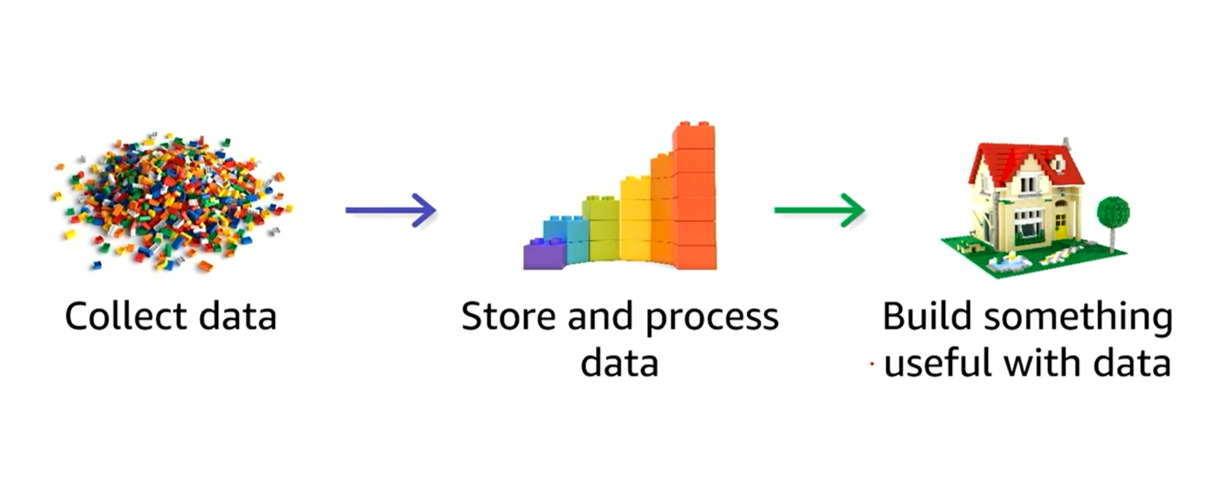
Data Pipeline

Slide 10
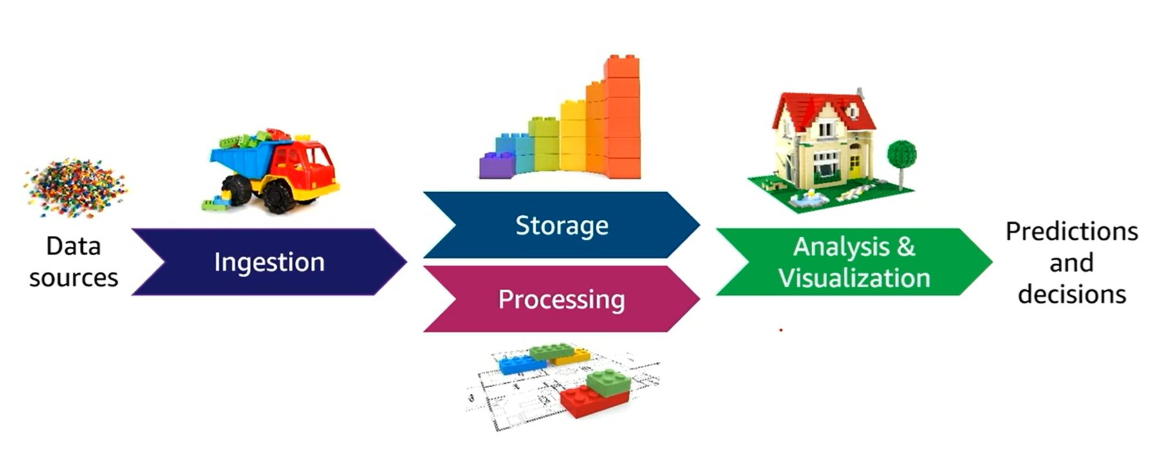
Layers of pipeline infrastructure

Slide 11
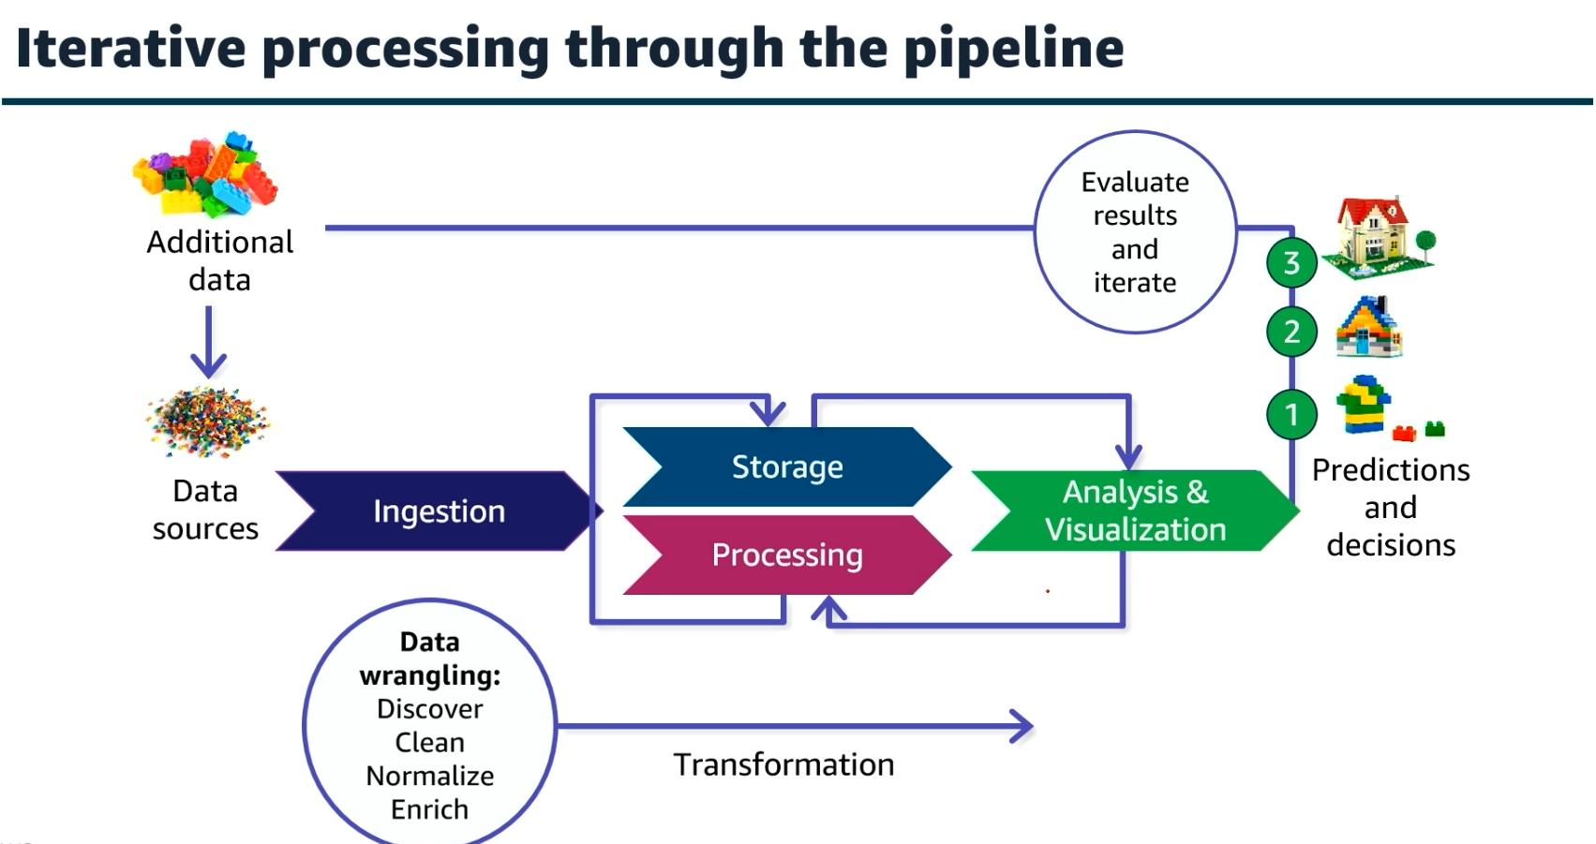
Iterative processing through the pipeline

Slide 12
Ingesting and Preparing Data
Contents
Data wrangling
Data wrangling Steps:
Discovery
• Structuring
• Cleaning
• Enriching
• Validating
• Publishing

Slide 13
Data Wrangling
Transforming large amounts of unstructured or structured raw data from multiple sources with different schemas into a meaningful set of data that has value for downstream processes or users

Slide 14
Data Wrangling Steps
Discovery: Understand the data by checking its initial content, looking at data definitions, and examining its basic features and issues.
Structuring: Organize data into a clear format, fix any redundant information, adjust data types, and set up indexing for quick access.
Cleaning: Fix errors, remove duplicates, fill in missing information, and make sure the data is consistent and accurate.
Enriching: Improve data by combining it from different sources, creating new features, adding descriptions, and including location details.
Validating: Ensure data is correct by checking accuracy, applying rules, spotting unusual values, and measuring overall data quality.
Publishing: Prepare data by documenting details, saving it in useful formats, sharing it with others, and setting up security measures.

Slide 15
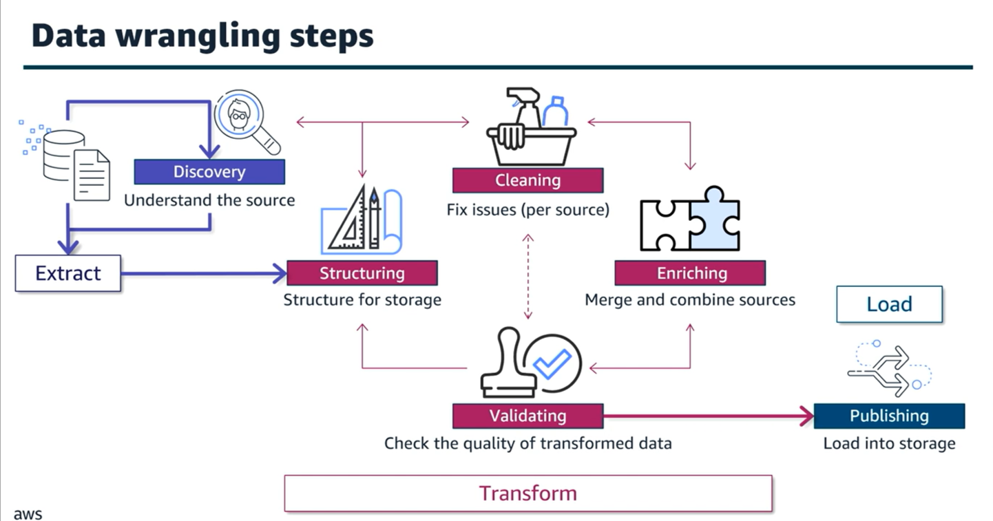
Data Wrangling Steps

Slide 16
Real Time applications
Financial Fraud Detection: Analyzing transaction data in real-time to detect and prevent fraudulent activities, such as unauthorized credit card transactions or suspicious account behavior.
IoT Device Monitoring: Collecting and processing data from connected devices (e.g., smart thermostats, wearables) in real-time to provide immediate feedback and alerts.
Real-Time Customer Support: Using chatbots and live data to provide instant responses and solutions to customer inquiries and issues.
Smart City Traffic Management: Monitoring traffic patterns and adjusting traffic signals in real-time to reduce congestion and improve traffic flow.

Slide 17
Learning outcomes
Data Pipeline Design and Implementation.
Data Storage and Management.
Data Processing and Transformation.
Real-Time Data Handling.

Slide 18
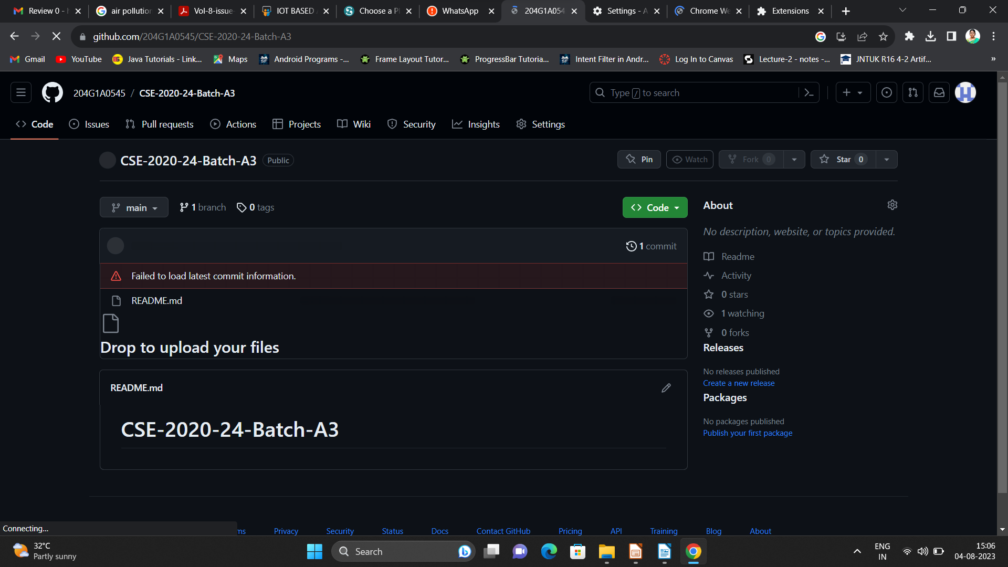

Git Hub Dashboard
Repository Name Like: Summer Internship - I
Under that include document, presentation and Certificate(Pdf).

Slide 19
Any Queries?

Slide 20
Thank You!!!

